Slide 1
Salamander Macroevolution
Joanna & Jon

Slide 2
Salamander project
Pile of data:
Joanna had salamander measurements
Jon added fossils measurements
Tree from Pyron, geography from IUCN
Neoteny scores from literature search
Lots of turn-the-crank analyses
Seeking suggestions for additional data/analyses and structure

Slide 3
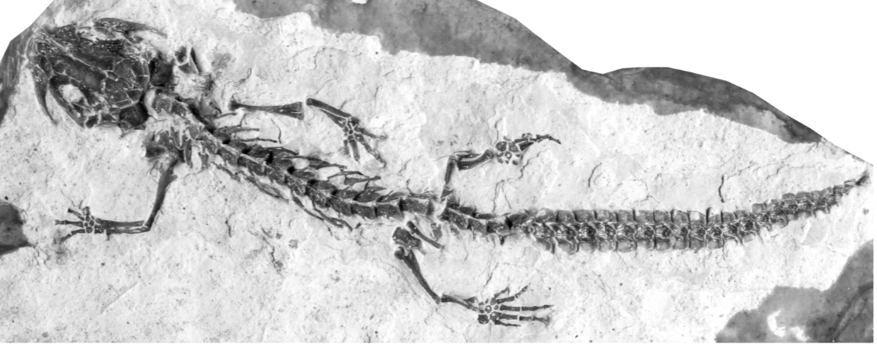
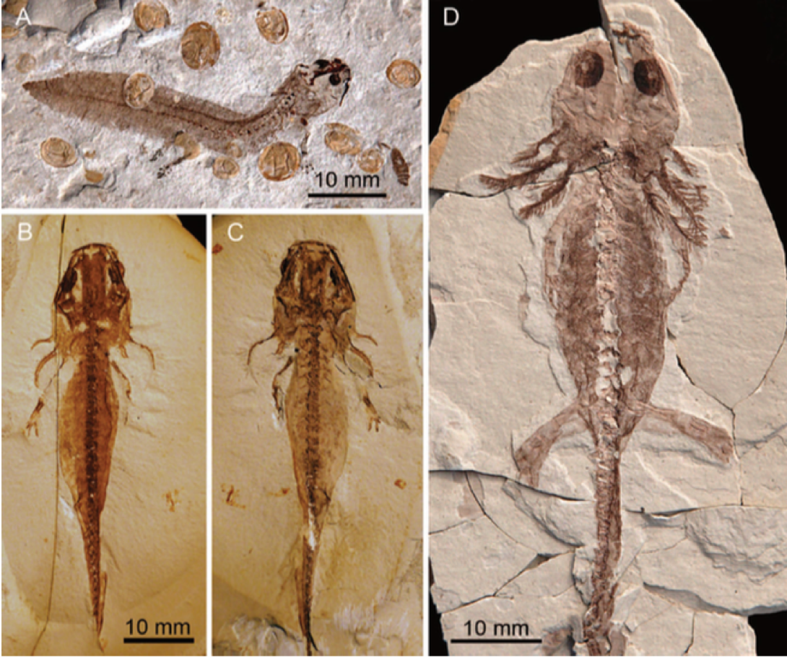
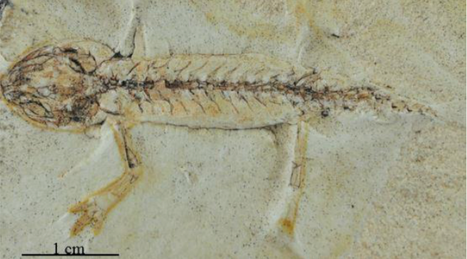
Fossil salamanders
Notes:
Salamander larvae from China
Ichthyosaura randeckensis from Randeck Maar in Germany
Taricha oliginacea from Gray Butte

Slide 4
Salamanders don’t care about:
The LDG

Slide 5
Salamanders don’t care about:
The LDG
The end-Cretaceous mass extinction

Slide 6
Salamanders don’t care about:
The LDG
The end-Cretaceous mass extinction
The proper order of development

Slide 7
What we have
Data on:
Phylogeny (469 species; Pyron 2014)
Body size (Joanna’s measurements + fossils)
Geography (from IUCN)
Fossil occurrences (from PBDB)
Neoteny (from literature)
Development

Slide 8
Angles of attack
Speciation & extinction rates
Body size evolution
Biogeography
Life history evolution

Slide 9
Speciation & Extinction
469 extant species
84 fossil species with known phylogenetic placement
Append fossils to tree: ((A,B),X)
A
B
X
Notes:
Generated by fitting CR BD model to extant salamander phylo to get lambda and mu. Then calculated psi as # fossil occurrences / sum branch lengths on extant tree. Should be underestimate of psi given no fossil BRLENS

Slide 10
Speciation & Extinction
469 extant species
84 fossil species with known phylogenetic placement
Append fossils to tree: ((A,B),X)
A
B
X
Minimum
Missing
Unknown
Notes:
Generated by fitting CR BD model to extant salamander phylo to get lambda and mu. Then calculated psi as # fossil occurrences / sum branch lengths on extant tree. Should be underestimate of psi given no fossil BRLENS

Slide 11
Speciation & Extinction
469 extant species
84 fossil species with known phylogenetic placement
Append fossils to tree: ((A,B),X)
A
B
X
Minimum
Missing
Unknown
Notes:
Generated by fitting CR BD model to extant salamander phylo to get lambda and mu. Then calculated psi as # fossil occurrences / sum branch lengths on extant tree. Should be underestimate of psi given no fossil BRLENS

Slide 12
Plethodontids are problematic
Plethodontidae
Notes:
Young plethodontid fossils can be identified to genus, but no idea if same or different from extant species within that genus
Old plethodontid fossils can be identified, but no idea where they go on the tree

Slide 13
Ran fossilBAMM on trees with fossils
Fossil branches scaled by simple rates
Extant-only run
fossilBAMM with observed number of occurrences
fossilBAMM with 10X number of occurrences

Slide 14
Fossils change Salamandridae a lot
Speciation

Slide 15
Ran fossilBAMM on trees with fossils
Speciation through time
Extinction through time

Slide 16
Ran fossilBAMM on trees with fossils
Net div. through time
Rel. extinction through time

Slide 17
Ran BAMM on snout-vent length
SVL Rate

Slide 18
Fossils smooth out size evolution
Notes:
Extant-only has lots of small size tips, but some depauperate clades are really big. Only way to accommodate is to have high rates at deep nodes. With fossils, lots of large taxa sprinkled through tree, so no need for a big jump.

Slide 19
Larger size at key crown nodes with fossils

Slide 20
Biogeography of salamanders

Slide 21
Biogeography of salamanders

Slide 22
Six biogeographic provinces

Slide 23
BioGeoBEARS to infer ancestral ranges
Fossils present a problem
Treat observed ranges as “hard” or “soft” constraint
000100 vs ???1??
In-between options exist
Ambiguities “smear” fossils across provinces
Pro: Reflects uncertainty
Con: Unrealistically large ranges
DEC*+JV preferred model

Slide 24
Fossil constraints change critical nodes
Hard constraint
Soft constraint

Slide 25
Lineages-through-time per province
At time = t, find all edges alive
Find the probability each edge is in each province
Sum probs. for each province across edges alive at time = t

Slide 26
Estimate number of lineages per-province
Hard constraint
Soft constraint

Slide 27
Focus on East Asia, Europe and Eastern NA
Hard constraint
Soft constraint

Slide 28
Compare estimate with fossil occurrences
Hard constraint
Soft constraint

Slide 29
Center of origin for each node

Slide 30
Neoteny
No review of salamander neoteny
~10% of all species
All families but Rhyacotritonidae
Three states:
No neoteny (0; e.g., Salamandra salamandra)
Facultative neoteny (1; e.g., Ambystoma tigrinum)
Obligate neoteny (2; e.g., Amphiuma means)

